Slide 1
Capstone Engagement
Assessment, Analysis, and Hardening of a Vulnerable System
By Timothy Applewhite

Slide 2
Table of Contents
This document contains the following sections:
01
Network Topology
02
Red Team: Security Assessment
03
Blue Team: Log Analysis and Attack Characterization
Hardening: Proposed Alarms and Mitigation Strategies
04

Slide 3
Network Topology
‹#›

Slide 4
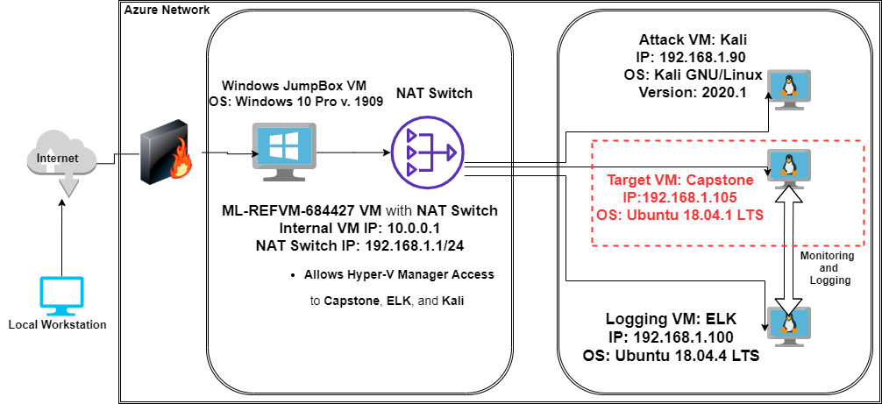
Network Topology
[Insert Here]
Use draw.io to create a diagram of the network.
Add your diagram to this slide and fill out the data in the sidebar.
Network
Address Range: 192.168.1.1/24
Netmask: 255.255.255.0
Gateway: 10.0.0.1
Machines
IPv4: 192.168.1.1
OS: Windows 10 Pro
Hostname: ML-REFVM-684427
IPv4:
OS: Kali GNU Linux
Hostname: Kali
IPv4: 192.168.1.105
OS: Ubuntu 18.04.1 LTS
Hostname:Capstone
IPv4: 192.168.1.100
OS: Ubuntu 18.04.4 LTS
Hostname: ELK

Slide 5

Red Team
Security Assessment
‹#›

Slide 6
Recon: Describing the Target
Nmap identified the following hosts on the network:
Hostname | IP Address and OS | Role on Network
Capstone | IP: 192.168.1.105 OS: Linux Ubuntu 18.04.1 LTS | Target Webserver VM. Forwards logs to ELK Machine on Kibana Dashboards.
ELK | IP: 192.168.1.100 OS: Linux Ubuntu 18.04.4 LTS | SIEMs VM for Logs utilizing Elasticsearch, Logstash, and Kibana.
Kali | IP: 192.168.1.90 OS: Kali GNU/Linux v. 2020.1 | Penetration Testing Attack VM. Linux VM equipped with Pen-Testing Tools.
ML-REFVM-684427 | IP: 192.168.1.1/24 OS: Windows 10 Pro v. 1909 | Microsoft Jumpbox VM with NAT Switch for connectivity to the Capstone, ELK, and Kali VMs.

Slide 7
Vulnerability Assessment
The assessment uncovered the following critical vulnerabilities in the target:
Vulnerability | Description | Impact
Apache Server Security Misconfiguration | Sensitive files are visible to the public through Port 80 HTTP web navigation. Ashton has posted instructions to connect to WebDAV and is using Ryan’s credentials, which are listed in passwd.dav. | Allows attackers to gain guided access to WebDAV server in order to navigate and perform reconnaissance, locating sensitive data, such as the “secret folder”. Poor Credentialing Policy and Administration by Ashton makes this possible.
Brute Force Vulnerability | There is no limit set for failed HTTP requests by Status Code, nor Success/Fail Rate, which allows Brute Force Attacks. | Provides access to the (what Ashton thought) was the inaccessible “secret folder”, which allowed for attackers to gain to instructions on how to access WebDAV server and Ryan’s hashed password for decryption.
Remote Code Execution | There is no alert set up to monitor, nor rule setup, to deny any incoming traffic from foreign Source IP’s on the default Meterpreter Port 4444. | Allows attacker to execute remote code and maintain Command and Control over Webserver.

Slide 8
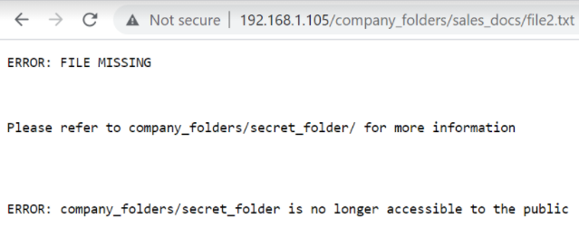
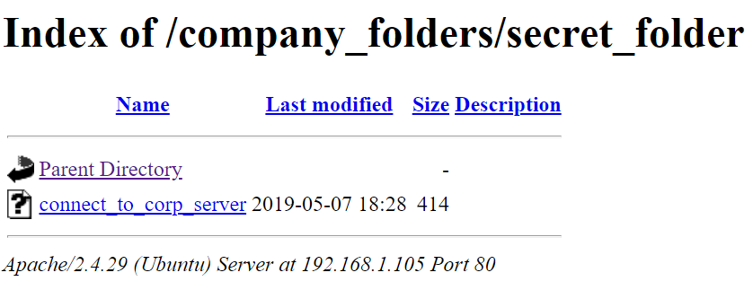
Exploitation: Overall Security Misconfiguration
01
02
03
Tools & Processes
Used bash command line in terminal on Capstone VM to discern IP.
Exploited the fact that Administrator Ashton has left Apache Webserver configured to have Directory Listing Enabled.
Used Web Browser to go directly to Capstone IP 192.168.1.105 and explore VSI’s company directory with free rein.
Achievements
Located /secret_folder/
Found Ashton’s “Personal Note” instructions in file (connect_to_corp_server) for connectivity and Ryan’s credentials for access.
Accessed /webdav/ via Brute Force gaining Ryan’s hashed password and cracked it with www.crackstation.net
Connected to WebDAV Server and uploaded PHP Reverse Shell executable, shell.exe
[INSERT: screenshot or command output illustrating the exploit.]

Slide 9
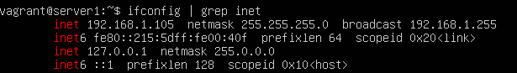
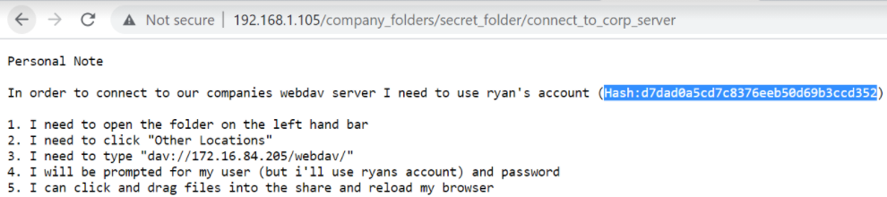
Exploitation: Overall Security Misconfiguration (continued)
Reference Screenshots of Misconfigured Security Browser Exploit
Bash Command to Identify IP Address of Capstone VM:
Administrator Ashton’s “Personal Note” with WebDAV Connectivity Instructions with Ryan’s Hash:

Slide 10
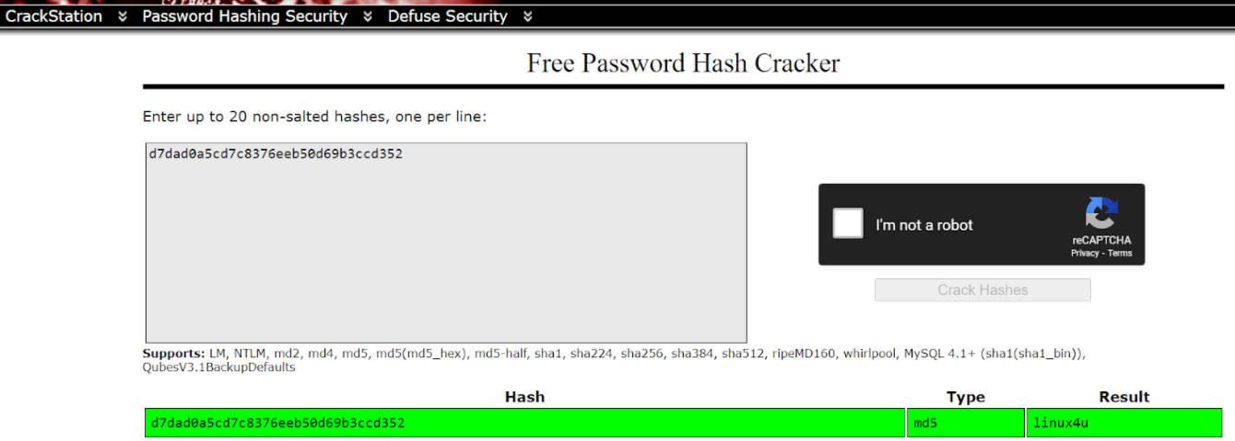
Exploitation: Overall Security Misconfiguration (continued)
Reference Screenshots of Misconfigured Security Browser Exploit
Use of www.crackstation.net to Crack Ryan’s Password Hash for access to /web_dav/ directory

Slide 11
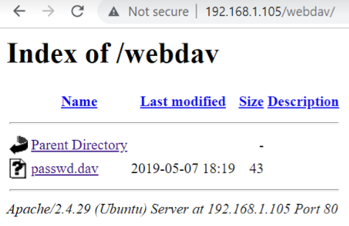
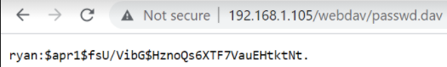
Exploitation: Overall Security Misconfiguration (continued)
Reference Screenshots of Misconfigured Security Browser Exploit
Accessed /webdav/ directory
Gained Ryan’s Hashed Credentials to Brute Force Decrypt to Gain Full Remote Connectivity to Server

Slide 12
Exploitation: Brute Force Vulnerability
01
02
03
Tools & Processes
I used bash commands in the terminal to unzip the wordlist needed for the Brute Force Reference Dictionary.
Then, I used the tool Hydra to Brute Force the credentials for Ashton.
Achievements
Brute Forcing Ashton’s credentials was necessary to gain initial access to the previously documented /secret_folder/ directory.
Without access to the “Personal Note” of Ashton entitled connect_to_corp_server, we would not know to use Ryan’s hashed password for /webdav/
Connected to WebDAV Server to upload PHP Reverse Shell executable and obtain C2.
Please see the following slide for Screenshot Examples of the Brute Force Attack using Hydra.

Slide 13
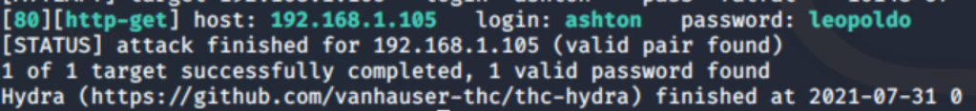
Exploitation: Brute Force Vulnerability
Reference Screenshots of Brute Force Vulnerability Exploit
After unzipping rockyou.txt.gz with the Bash Command “gunzip”, I used the following Bash Command to use the tool Hydra in order to Brute Force Ashton’s Credentials.
The following is a screenshot of the Output from the prior command, displaying Ashton’s Credentials

Slide 14
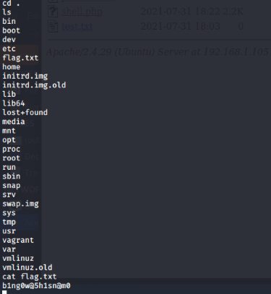
Exploitation: Remote Code Execution
01
02
03
Tools & Processes
I used msfvenom to construct a custom payload, shell.php, in the command line terminal.
I used Meterpreter, a type of Metasploit payload that provides an interactive shell.
Once gaining a command line, executed bash on the WebDAV Server and exfiltrated data while establishing C2 (Command and Control).
Achievements
Established full command and control of the Apache Server via PHP Reverse Shell upload to the WebDav Apache Server.
Then, Metasploit executed the Reverse TCP payload to gain terminal within WebDAV.
Last, I was able to establish a shell with Meterpreter and execute terminal bash commands to exfiltrate passwd.dav and capture flag.txt.
Capturing the Flag:

Slide 15
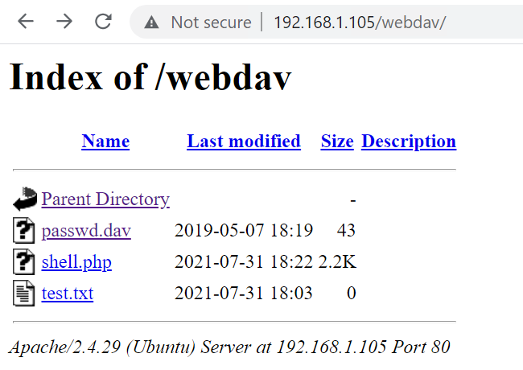
Exploitation: Remote Code Execution
Screenshot of msfvenom Custom Payload Construction via Command Line
Confirmation via Chrome Browser that exploit has worked, and that the /webdav/ directory now has two unauthorized uploaded files from the Kali VM.
shell.php
test.txt

Slide 16
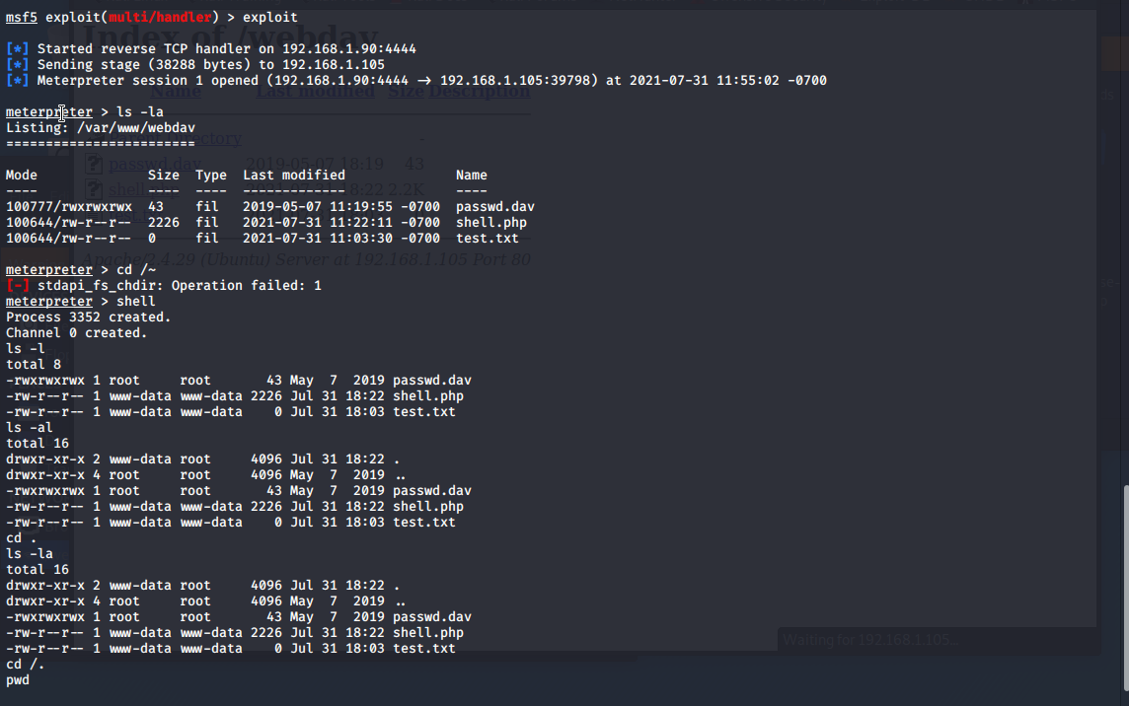
Exploitation: Remote Code Execution
Screenshot of Full Meterpreter Exploit Output

Slide 17

Blue Team
Log Analysis and Attack Characterization
‹#›

Slide 18
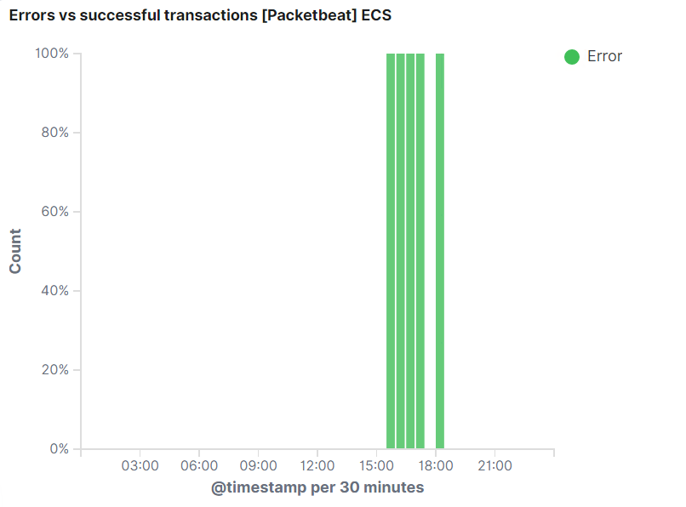
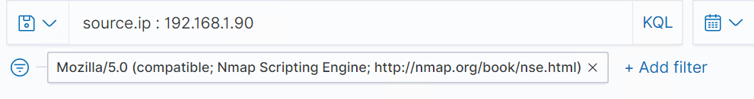
Analysis: Identifying the Port Scan
The Port Scan occurred on July 31, 2021 at 3:39 PM G.M.T.
178 Packets from IP 192.168.1.90
We can tell this is a port scan because it includes multiple ports.

Slide 19
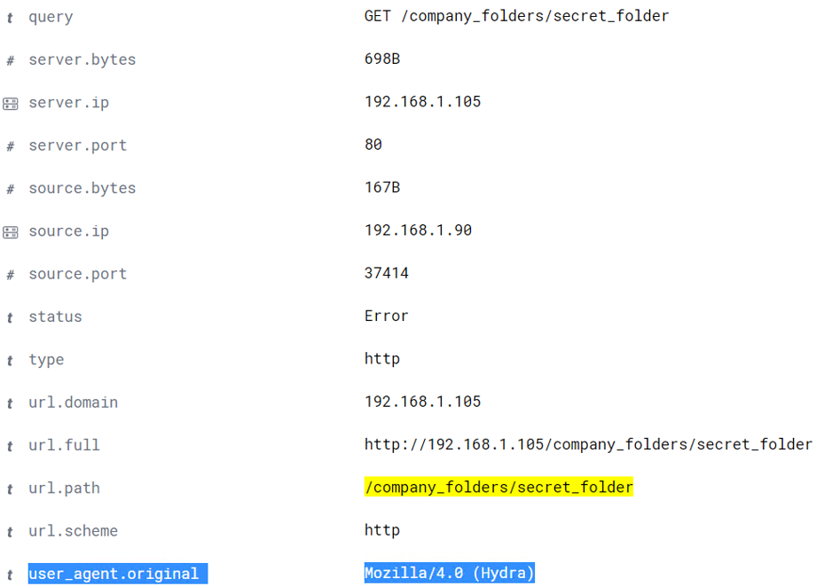
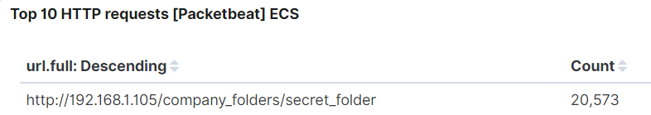
Analysis: Finding the Request for the Hidden Directory
[Insert Here]
Include a screenshot of Kibana logs depicting the request for the hidden directory.

Slide 20
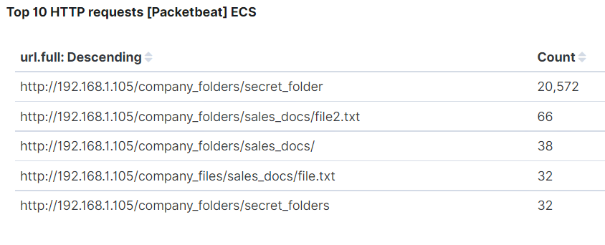
Analysis: Finding the Request for the Hidden Directory
Details:
The request began at 4:37 PM G.M.T. And 20.572 Requests were made
The following files and their contents were requested.
http://192.168.1.105/company_folders/sales_docs/file2.txt contained the location of the secret directory
http://192.168.1.105/company_folder/secret_folder/connect_to_corp/server is contained within the /secret_folder/ directory and is Ashton’s Personal Note giving instructctions on how to connect to the /webdav/ directory, and, thus, the Apache Webserver

Slide 21
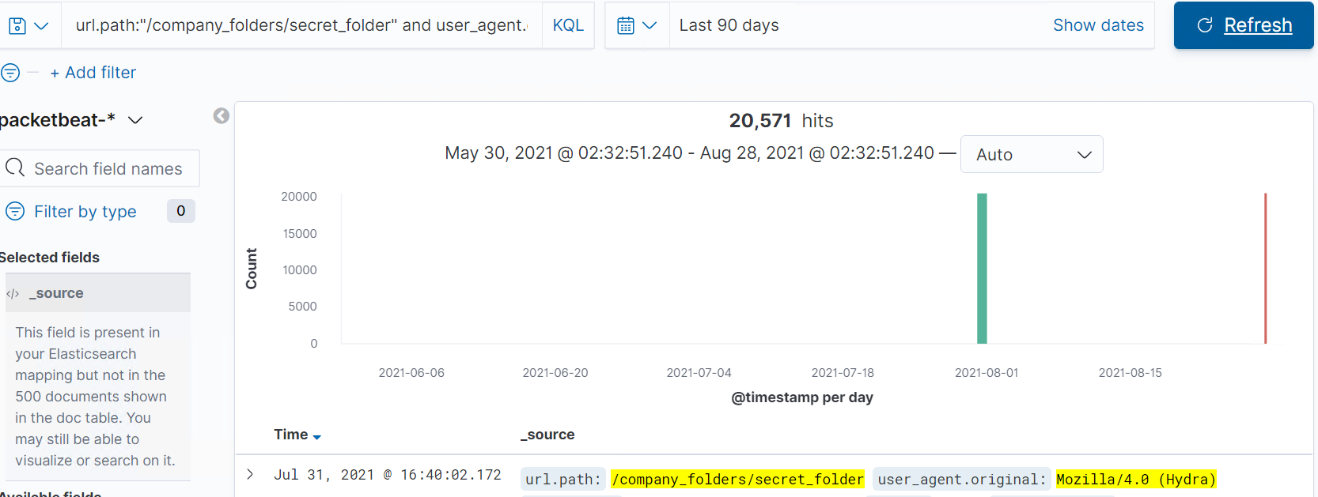
Analysis: Uncovering the Brute Force Attack
[Insert Here]
Include a screenshot of Kibana logs depicting the brute force attack.

Slide 22
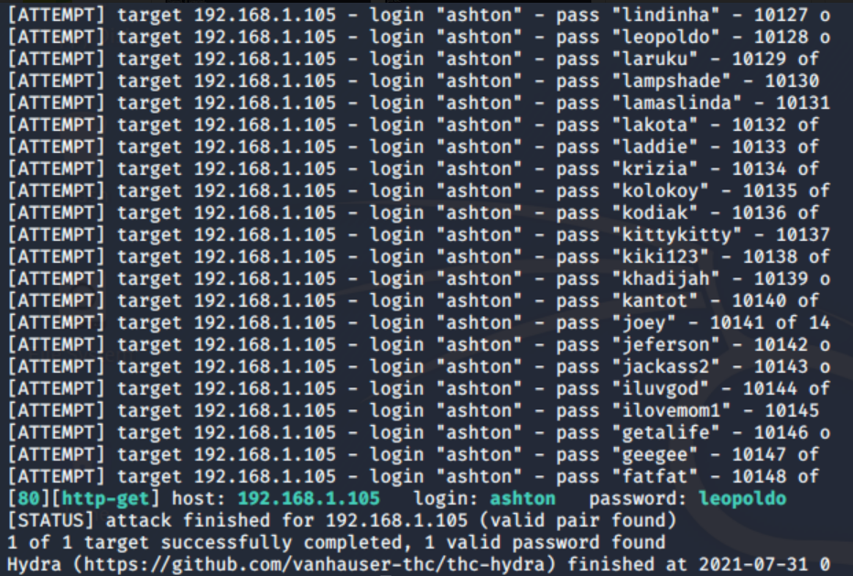
Analysis: Uncovering the Brute Force Attack
Details:
20,571 Requests were made during the Brute Force Attack
10,148 Requests were made before the password was attained via Brute Force.

Slide 23
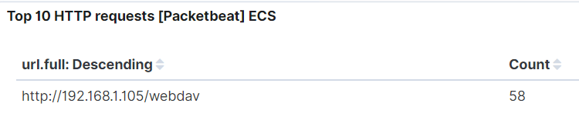
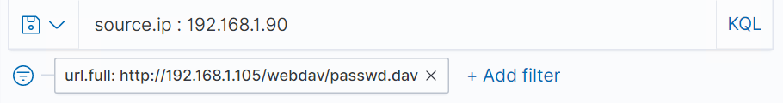
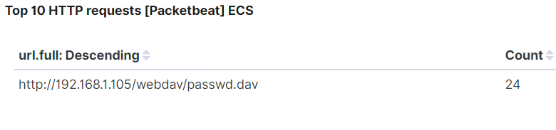
Analysis: Finding the WebDAV Connection
58 Requests were made to the http://192.168.1.105/webdav/ directory
The file passwd.dav was specifically requested 24 times.
[Insert Here]
Add a screenshot of Kibana logs depicting the WebDAV connection.

Slide 24
Blue Team
Proposed Alarms and Mitigation Strategies
‹#›

Slide 25
Mitigation: Blocking the Port Scan
What kind of alarm can be set to detect future port scans?
We can set an alarm to go off for any unauthorized activity on ports other than 80 and 443 that exceeds a set number of Ports per Source IP per Minute.
What threshold would you set to activate this alarm?
I would err on the side of caution; and, thus, have an alert go off if more than 4 ports are being interacted with from the same Source IP per Minute.
What configurations can be set on the host to mitigate port scans?
A strong Firewall must be implemented that specifically prevents port scanning and is configured to not allow for a single Source IP to utilize more than 4 ports per minute. Furthermore, the Kibana Dashboard must be configured to alert staff in real time for potential port scanning so as to mitigate the amount of damage that can be done by addressing the potential attack while still in the Scanning Phase.

Slide 26
Mitigation: Finding the Request for the Hidden Directory
What kind of alarm can be set to detect future unauthorized access?
An alarm can be configured to go off based off of the number of times that any external IP seeks to access the url.path containing *secret_folder*.
What threshold would you set to activate this alarm?
I would not permit any access to this directory from any external IP without an alert being triggered by whitelisting our company IP’s, such as 192.168.1.105 and 192.168.1.1.
The configuration file of the host must be edited to block all traffic from non-specified, whitelisted IP’s and the Apache Server’s Directory Listing option must be disabled.
Commands:
nano /etc/httpd/conf/httpd.conf
Edit and Add <Directory/var/www/company_folders/secretfolder/> to the /var/www/ section of the “httpd.conf” file.
Set to Allow from 192.168.1.1/24
Set to Allow from 192.168.1.105
Set to Deny from 192.168.1.90
Close with </Directory>
Lastly, remove “Indexes” from the Options portion.

Slide 27
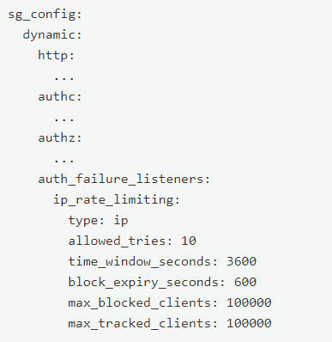
Mitigation: Preventing Brute Force Attacks
What kind of alarm can be set to detect future brute force attacks?
An alarm should be set to go off based off of the number of Failed Login HTTP Response Code attempts to any given resource.
What threshold would you set to activate this alarm?
I would set the alarm to sound if there were more than 10 failed login attempts per 10 minutes.
First, implementing a Strong Password Policy with Two-Factor Authentication is a must.
Next, we must edit the “sg_config.yml” file with the following:

Slide 28
Mitigation: Detecting the WebDAV Connection
What kind of alarm can be set to detect future access to this directory?
I would set an alarm based off of any HTTP Request activity directed towards the url.path containing “webdav” from any non approved and whitelisted IP’s.
What threshold would you set to activate this alarm?
I would set the threshold at 0, because any HTTP Requests for Confidential Resources from Unauthorized IP’s should be looked into immediately.
Similar to preventing access to the aforementioned secret_folder directory, we must explicitly alter the “/etc/httpd/conf/httpd.conf” file.
Commands:
nano /etc/httpd/conf/httpd/conf
Edit and Add <Directory/var/www/webdav/> to the /var/www/ section.
Set to Allow from 192.168.1.1/24
Set to Allow from 192.168.1.105
Set to Deny from 192.168.1.80
Close with </Directory>

Slide 29
Mitigation: Identifying Reverse Shell Uploads
What kind of alarm can be set to detect future file uploads?
I would set up an alarm to sound whenever the HTTP Request Method “Put” is used directed towards the special resource of the url.path containing *webdav* that comes from a non-whitelisted Source IP.
What threshold would you set to activate this alarm?
Again, I would set the threshold to 0 for this resource because of the essential nature of its confidentiality. If any “Put” HTTP Requests occur from any unrecognized IP to this resource, an alarm should sound to prompt investigation.
Once again, the httpd.conf file must be edited with nano to specify that we want only specific IP’s to be allowed to access the /webdav/ resource, and to Deny All traffic that is not specifically Allowed. Most importantly, however, we must add the line:
<LimitExcept GET POST HEAD >deny from all
</LimitExcept>
</Directory>

